Slide 1
Interface
Nilanjana G. Basu, HITK

Slide 2
Introduction
Interfaces are developed to support multiple inheritance.
A class can extend one class and implement an interface
A class can implement multiple interfaces
Can a class extend multiple classes?
No. Not allowed in Java.

Slide 3
Introduction
Using interface, we specify what a class must do, but not how it does this.
An interface is syntactically similar to a class, but it lacks instance variables and its methods are declared without any body.
An interface is defined with an interface keyword.
Like abstract class, you cannot create instance of interface.

Slide 4
Introduction
Usually,
All the methods are by default public and abstract
All the variables are static and final both, i.e., constants in Java.
If a class implementing an interface does not define even one but every abstract methods in the interface, the class must declare itself an abstract class. This is called the partial implementation of the interface

Slide 5
Example 1
interface Admin{
void schedule_exam(int sem);
}
abstract class faculty{
int faculty_id;
String name;
faculty(int x, String s){ faculty_id=x;name=s;}
void display(){System.out.println(faculty_id +": "+name);}
abstract void teach(int sem);
}

Slide 6
Contd..
class hod extends faculty implements Admin{
hod(int x, String s){super(x,s);}
void teach(int sem){
if(sem==1){System.out.println("Intro to C");}
if(sem==3){System.out.println("DS & Algo");}
if(sem==4){System.out.println("D&A of Algorithms");}
}
public void schedule_exam(int sem){
if(sem==3){System.out.println("3rd sem schedule");}
//similar as above
}
}

Slide 7
Contd..
class interface_use{
public static void main(String args[]){
hod obj= new hod(123, "ABC");
obj.display();
obj.teach(3);
obj.schedule_exam(3);
}
}

Slide 8
Example 2
interface Admin{
void schedule_exam(int sem);
}
interface faculty{
void display();
void teach(int sem);
}

Slide 9
Contd…
class hod implements Admin, faculty{
int faculty_id;
String name;
hod(int x, String s){faculty_id=x;name=s;}
public void display(){System.out.println(faculty_id +": "+name);}
public void teach(int sem){
if(sem==1){System.out.println("Intro to C");}
if(sem==3){System.out.println("DS & Algo");}
if(sem==4){System.out.println("D&A of Algorithms");}
}
public void schedule_exam(int sem){
if(sem==3){System.out.println("3rd sem schedule");}
}}

Slide 10
Contd…
class interface_use_2{
public static void main(String args[]){
hod obj= new hod(123, "ABC");
obj.display(); obj.teach(3);obj.schedule_exam(3);
}
}

Slide 11
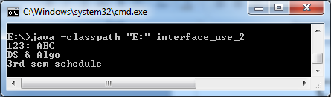
Output

Slide 12
Dynamic Method Dispatch
interface A{ void show();}
class B implements A{
public void show(){}
public void input(){}
}
class driver{
public static void main(String args[]){
A obj=new B();
obj.show();//DMD
//obj.input();//Error, obj is class A type, so input cannot be called
}}

Slide 13
Interface hierarchy
interface A{
void meth1();void meth2();
}
interface B extends A{
void meth3();
}
class C implements B{
//a class must implement every abstract methods in the interface //inheritance hierarchy, if not, then class C should be abstract
public void meth1(){…}
public void meth2(){…}
public void meth3(){…}
}

Slide 14
Default and static methods
interface A{
default void show(){System.out.println("Default");}
static void display(){System.out.println("Static");}
}
class Matrix implements A{
}

Slide 15
Contd..
class default_static_interface{
public static void main(String args[]){
Matrix obj=new Matrix();
obj.show();
A.display(); //obj.display() will give error
}
}

Slide 16
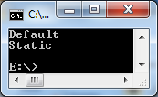
Output

Slide 17
Default and static methods
interface A{
default void show(){System.out.println("Default");}
static void display(){System.out.println("Static");}
}
class Matrix implements A{
public void show(){System.out.println("Sub_default");}
}

Slide 18
Contd..
class default_static_interface{
public static void main(String args[]){
Matrix obj=new Matrix();
obj.show();
A.display(); //obj.display() will give error
}
}

Slide 19
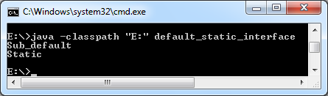
Output

Slide 20
Example Program
interface A{
default void show(){System.out.println("Default");}
static void display(){System.out.println("Static");}
}
class Matrix implements A{
public void show(){System.out.println("Sub_default");}
public void display(){
System.out.println("Sub_static");}//this is not implementing the interface static method
}

Slide 21
Contd…
class default_static_interface{
public static void main(String args[]){
Matrix obj=new Matrix();
obj.display();
obj.show();
A.display();
}
}

Slide 22
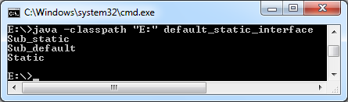
Output

Slide 23
Default methods
Java interface default methods will help us in extending interfaces without having the fear of breaking implementation classes.
Java interface default methods has bridge down the differences between interfaces and abstract classes.
Java 8 interface default methods will help us in avoiding utility classes, such as all the Collections class method can be provided in the interfaces itself.
Java interface default methods will help us in removing base implementation classes, we can provide default implementation and the implementation classes can chose which one to override.

Slide 24
Default methods
One of the major reason for introducing default methods in interfaces is to enhance the Collections API in Java 8 to support lambda expressions.
If any class in the hierarchy has a method with same signature, then default methods become irrelevant. A default method cannot override a method from java.lang.Object. The reasoning is very simple, it’s because Object is the base class for all the java classes. So even if we have Object class methods defined as default methods in interfaces, it will be useless because Object class method will always be used. That’s why to avoid confusion, we can’t have default methods that are overriding Object class methods.
Java interface default methods are also referred to as Defender Methods or Virtual extension methods.

Slide 25
Static methods
Java interface static method is part of interface, we can’t use it for implementation class objects.
These methods are good for providing utility methods, for example null check, collection sorting etc.
It helps us in providing security by not allowing implementation classes to override them.

Slide 26
Static Methods
We can’t define interface static method for Object class methods, we will get compiler error as “This static method cannot hide the instance method from Object”. This is because it’s not allowed in java, since Object is the base class for all the classes and we can’t have one class level static method and another instance method with same signature.
We can use java interface static methods to remove utility classes such as Collections and move all of it’s static methods to the corresponding interface, that would be easy to find and use.

